Slide 1


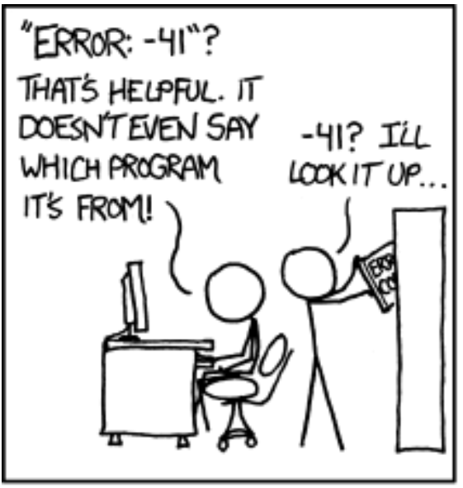
It doesn’t work!
André Roberge
PyConAu 2021
Education
Notes:
Welcome to « It doesn’t work », a talk given as part of the Education track of PyCon Australia 2021.
My name is André Roberge, joining you today from Canada where I live and have fun with Python.
Note that many slides shown during this talk include tiny xkcd cartoon panels, too small for you to read during the presentation:
These are intended to provide additional entertainment to people that have downloaded the slides.

Slide 2
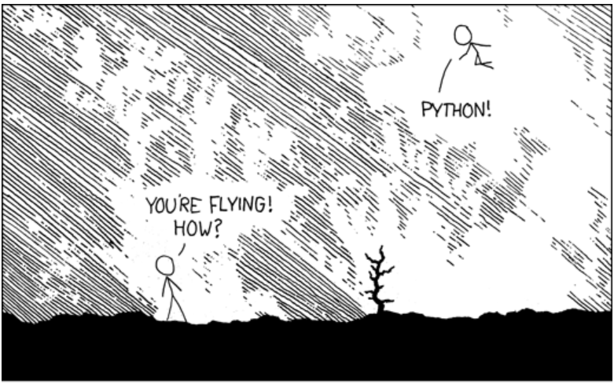

You are a teacher
Notes:
Since this is the education track, I am assuming that you have taught or plan to teach Python to someone else that I will refer to as « your students. »

Slide 3
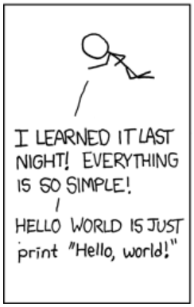
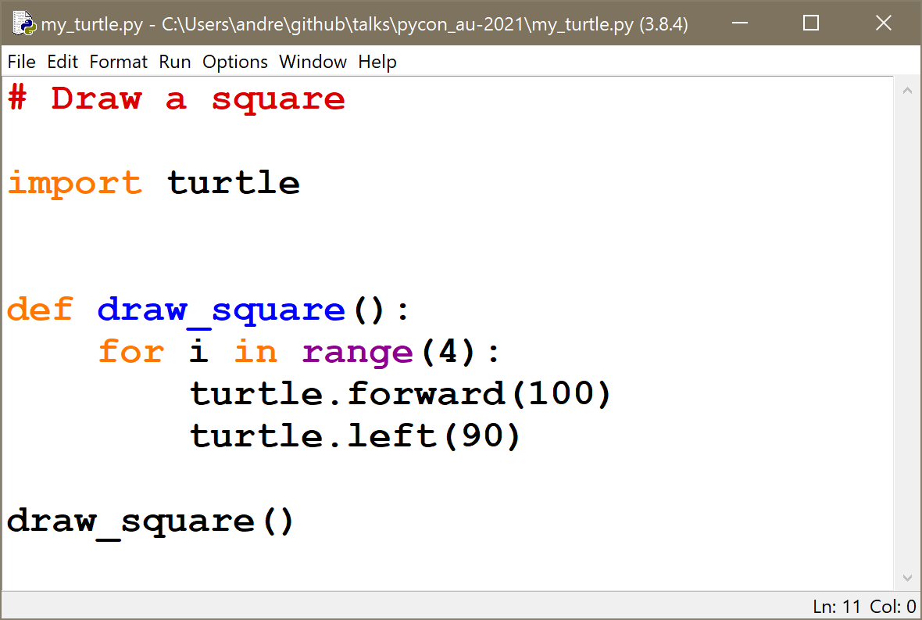
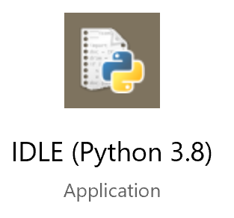
Example 1
Notes:
Your students have Python, including IDLE, installed on their computer.
You decide to introduce them to Python using the turtle module, starting with a complete example.

Slide 4
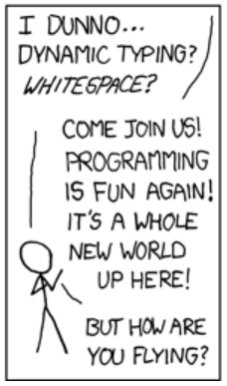
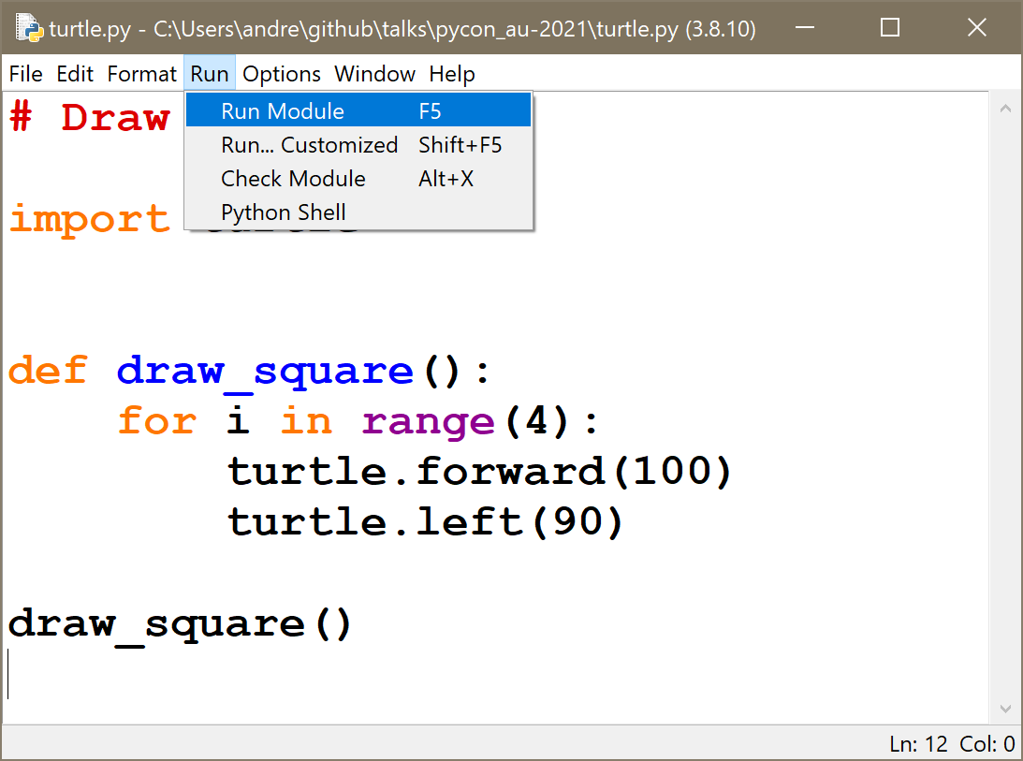
Example 1
Notes:
You show them how to run a program.

Slide 5
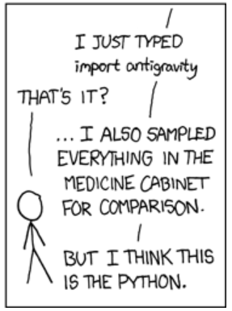
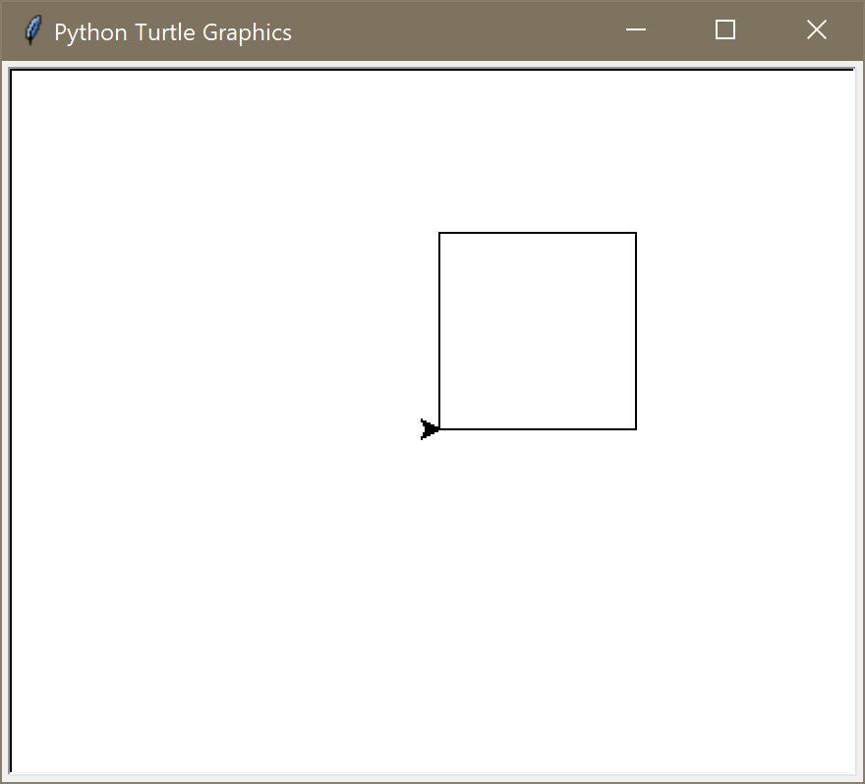
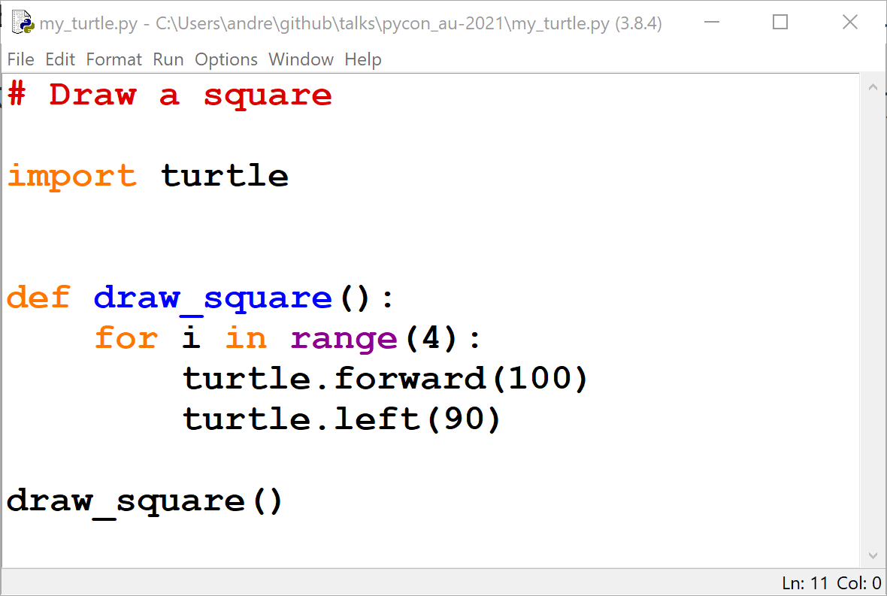
Example 1
Notes:
Success: a square has been drawn!

Slide 6
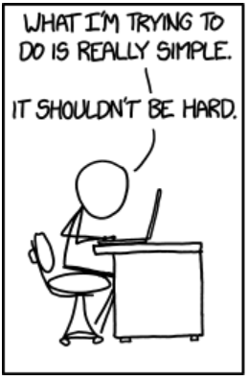
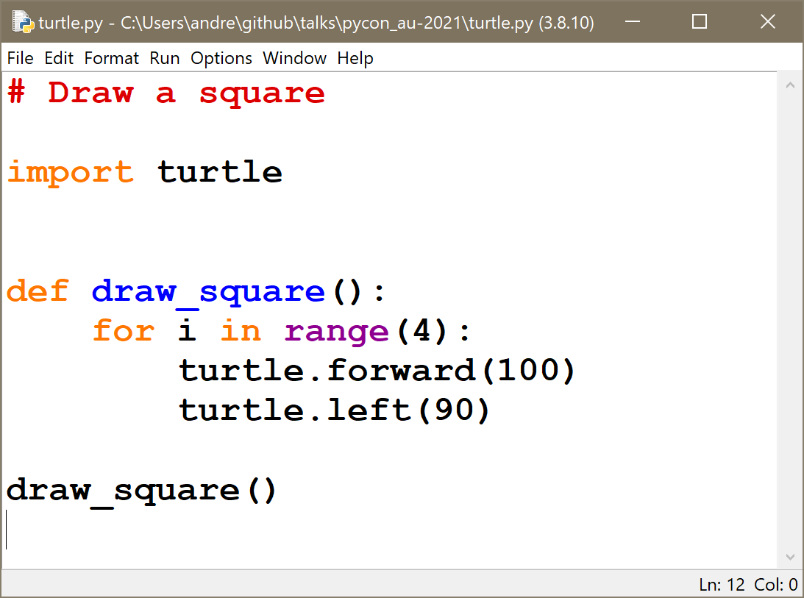
A student tries to reproduce this example
Notes:
Your students copy the code from your example … and attempt to run it.

Slide 7
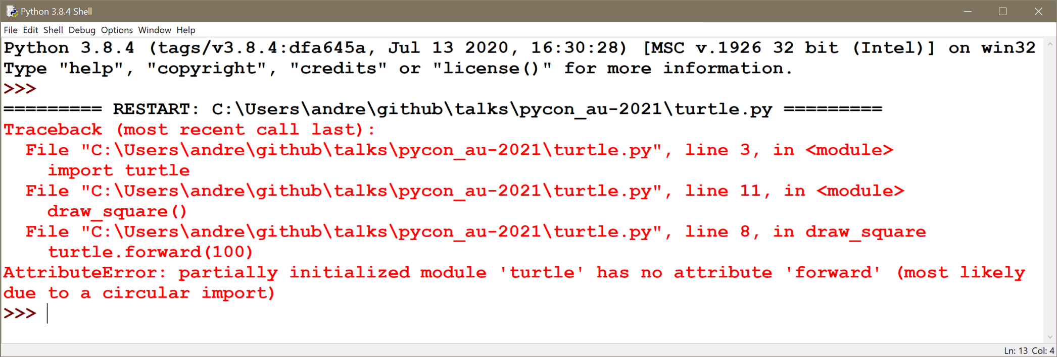
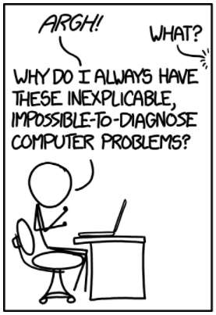
It doesn’t work!
Notes:
It doesn’t work.

Slide 8
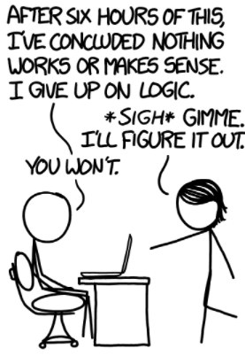
It doesn’t work!
Too much red
Too much jargon
Traceback, AttributeError, partially initialized module, circular import, …
Notes:
They see virtual red ink. In their experience, red ink is not a good thing.
They take a closer look at the content, and see a lot of unknown jargon: Traceback, AttributeError, partially initialized module, circular import, etc.
At this point, your students might get discouraged, thinking that programming is not for them: they feel inadequate and might just want to give up.

Slide 9
Could this be made more user-friendly?
Notes:
Could this be made more user friendly?
Before we see if this is possible, let’s review the type of information we can get from a normal Python traceback.

Slide 10
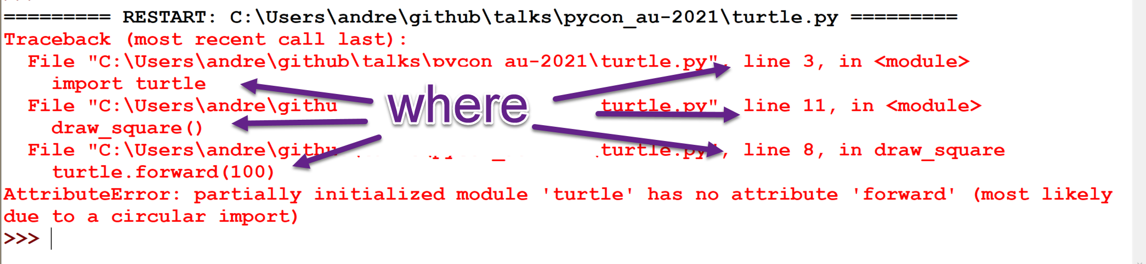
What the traceback tells us
Notes:
We can see where in the code the error occurred.

Slide 11
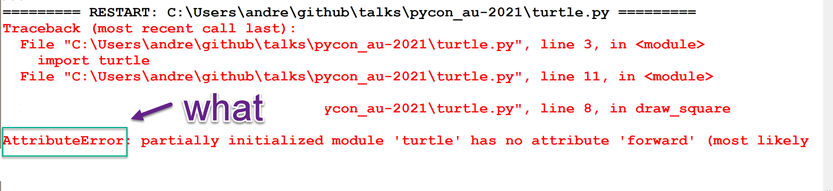
What the traceback tells us
Notes:
We can see what type of exception was raised.

Slide 12
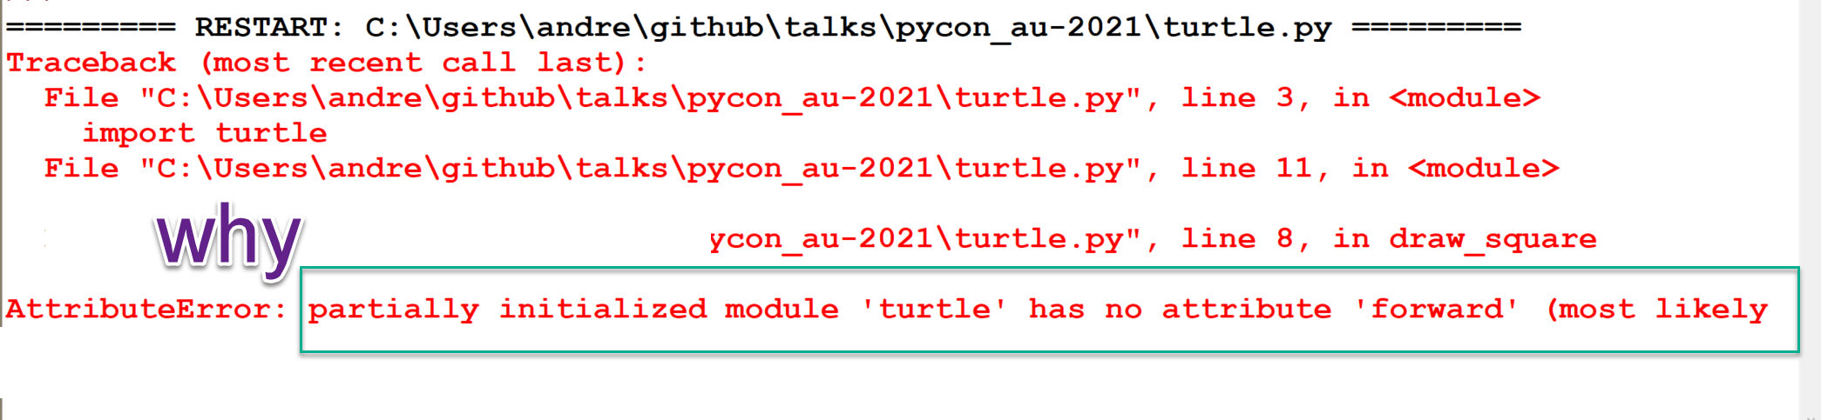
What the traceback tells us
Notes:
The message gives us an idea as to why the exception was raised.
Of course, it requires some experience to be able to decipher such tracebacks, something that we cannot expect beginners to be able to do on their own.
What if there existed a better way?

Slide 13
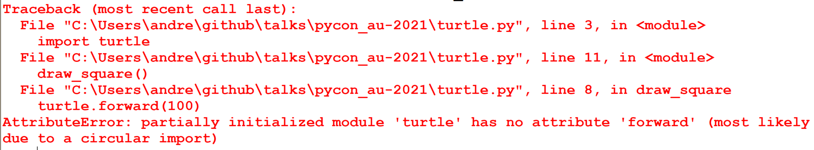
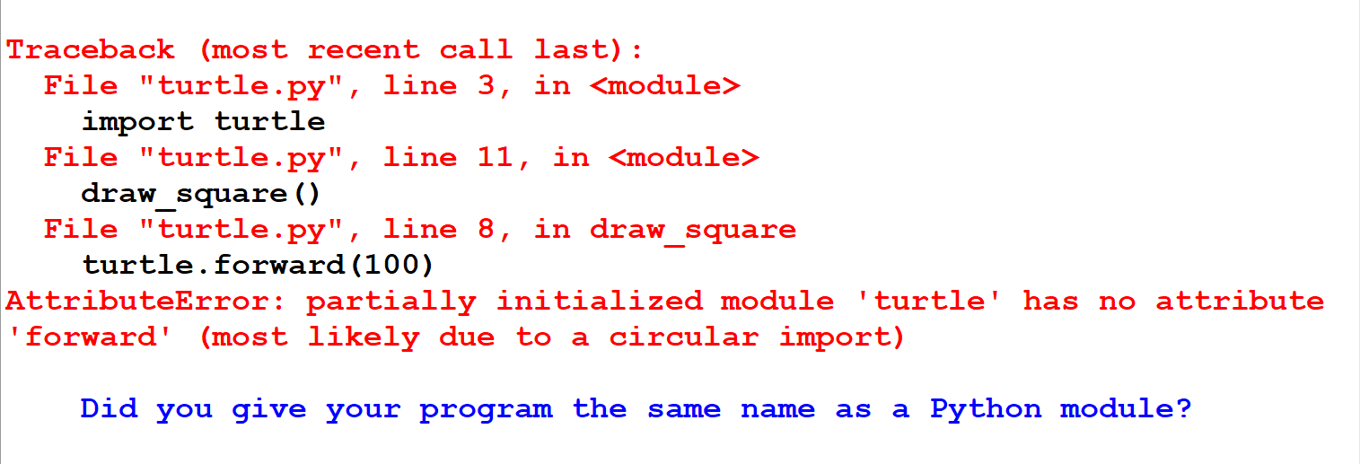
A bit less red … some black and blue
Notes:
On the left, we have a normal traceback.
What if we could have, like it is shown on the right side, a modified version, with shorter lines, and some black and blue in addition to the red.
Let’s zoom in to this modified traceback.

Slide 14
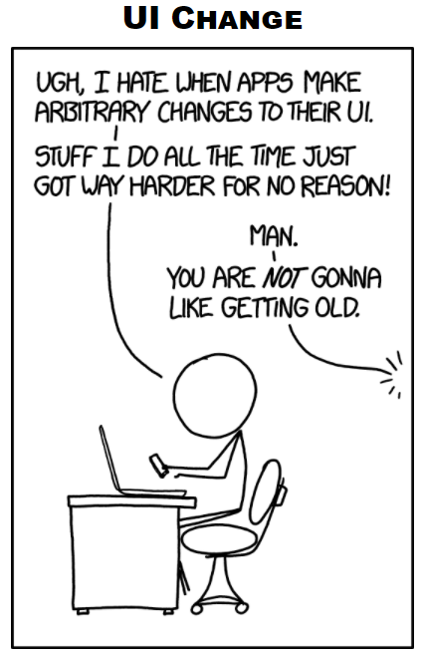
A bit less red … some black and blue
Notes:
This is the modified traceback.
Students might perhaps recognize more easily the text in black as being the code they wrote.
At the bottom, except for the word module, what if a nearly jargon-free easy to understand sentence was added, giving them a hint of what might be the source of their problem:
« Did you give your program the same name as a Python module? »

Slide 15
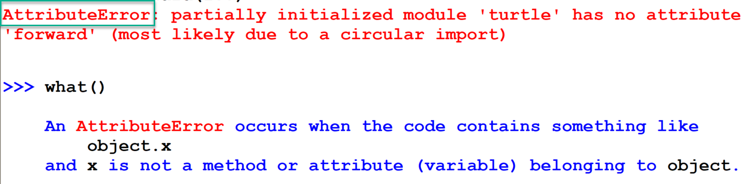
what()
Notes:
When using IDLE, we have access to a Python interpreter after running a program.
If students didn’t know about Python exceptions, what if asking “what” could reveal the meaning of AttributeError

Slide 16
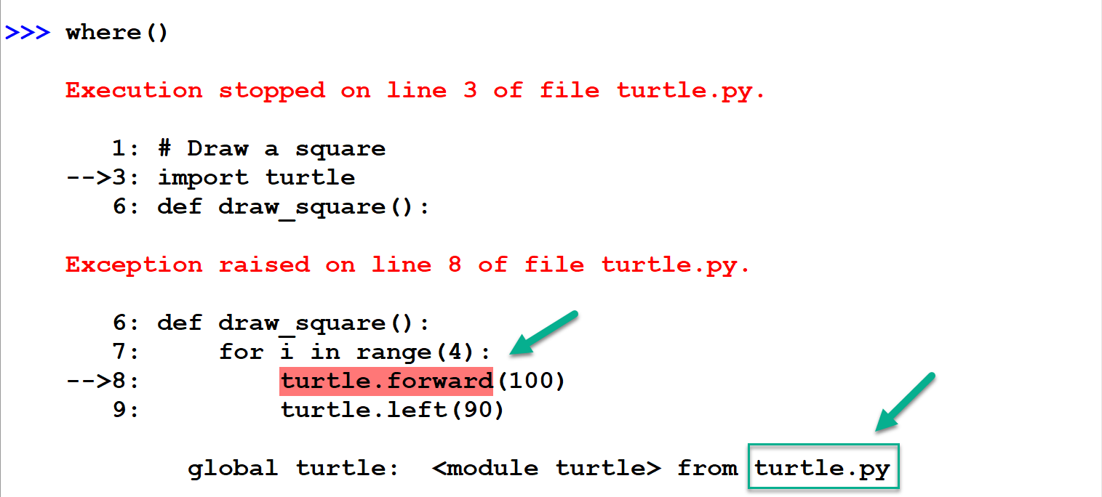
where()
Notes:
What if asking “where” would show the location of the error more explicitly than a traditional traceback would.
We see the part of a line highlighted in red, indicating the exact location of the problematic code.
At the bottom we see a reference to “turtle.py”.
Before continuing with this example, let me show you a similar “where” output from a different example.

Slide 17
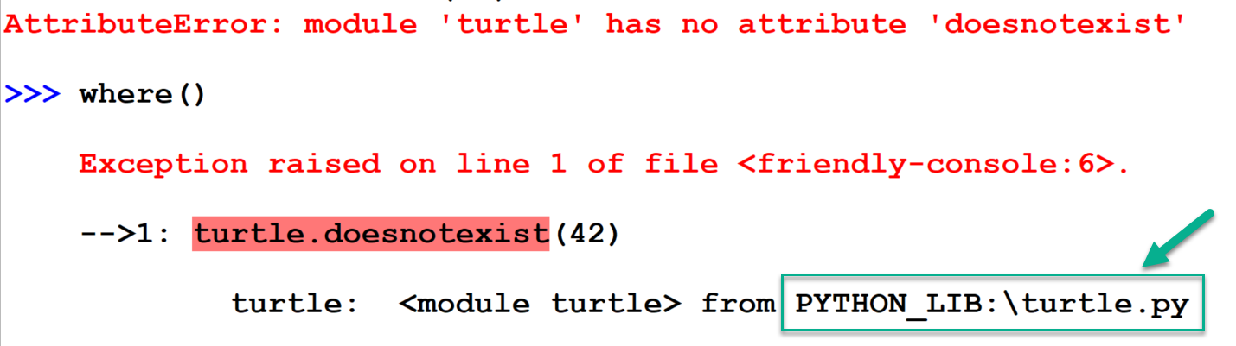
where() # other
Notes:
At the bottom, instead of “turtle.py”, we see “Python_lib:\turtle.py”: this tells us that the code is from
Python’s standard library, and not the code written by a student, unlike what we saw with the previous example.
Let’s go back to the example from the student.

Slide 18
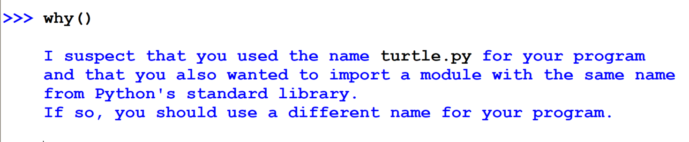
why()
Notes:
What if asking “why” give the student a more complete explanation as to what might have caused the problem they have encountered.
And, if this was not enough, what if there existed yet one more possibility.

Slide 19
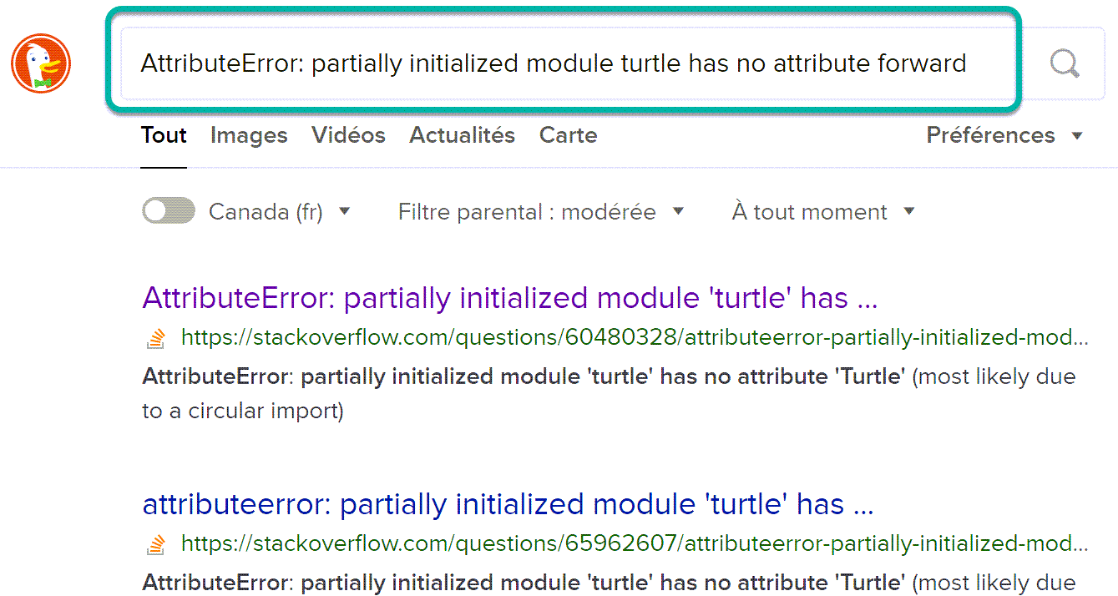
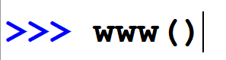
www()
Notes:
What if typing “www()” as a function used Python’s webbrowser module to do an Internet search, with the error message used as the search string?

Slide 20
All of this is possible using friendly (-traceback)
Notes:
All of this is possible using “friendly” or friendly-traceback.
Let’s have a look at a second example.

Slide 21
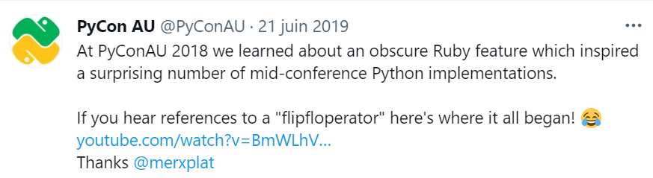
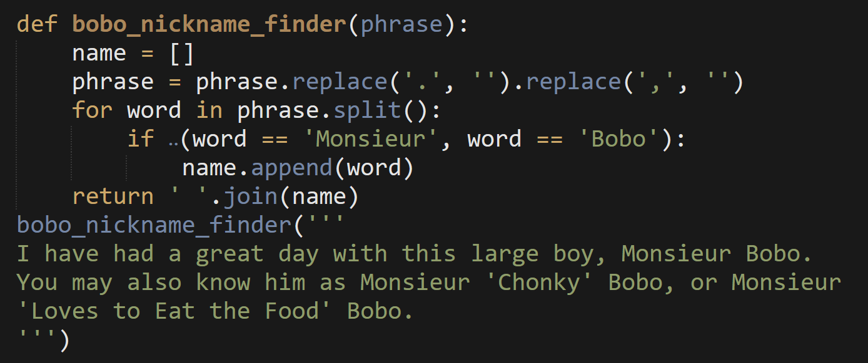
flipfloperator
Notes:
During PyCon Australia 2018, much fun was had talking about something called a flipfloperator.
The code shown on this slide was used in an example.
This code includes the text:
“I have had a great day with this large boy, Monsieur Bobo. You may also know him as Monsieur Chunky Bobo, or Monsieur Loves to eat the food Bobo”

Slide 22
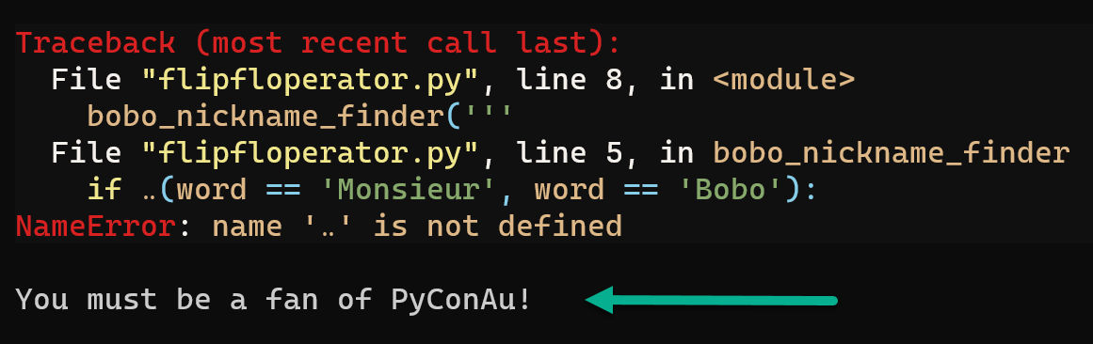
flipfloperator
Notes:
Here, I show the result when I attempt to run this example using friendly in a terminal instead of within IDLE.
I get a traceback with a NameError.
The text in white at the bottom is a hint added by Friendly.

Slide 23
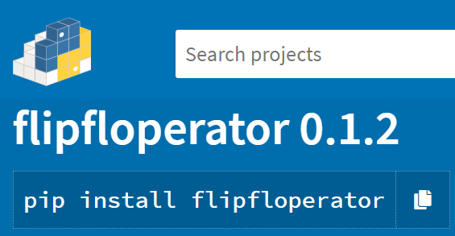
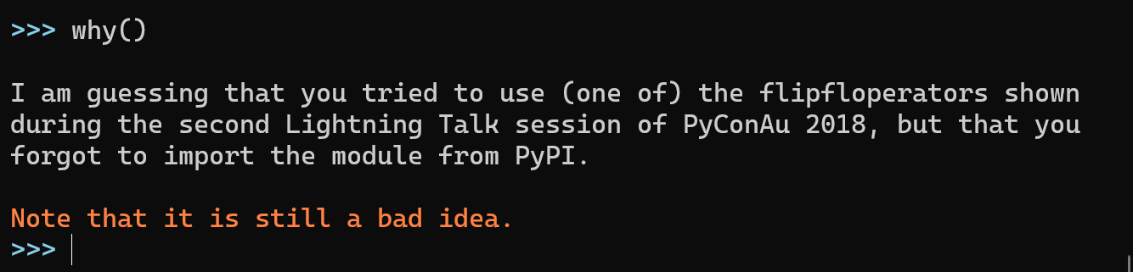
flipfloperator
Notes:
Asking why gives us a fuller explanation as to what might have gone wrong:
It suggests that we might have forgotten to install the module from PyPI.
Note that friendly also subscribes to the notion that using the flipfloperator is a bad idea.

Slide 24
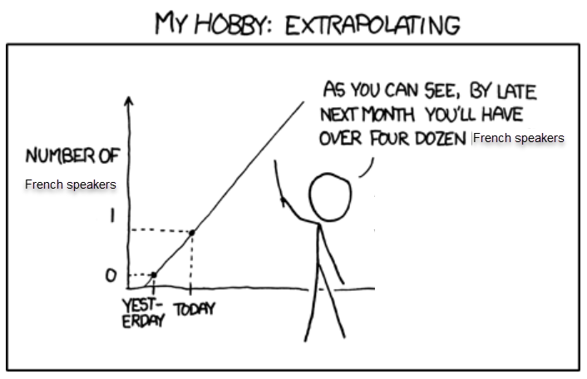
“Monsieur Bobo”
Notes:
When I watched the talks about the flipfloperator, I noticed the use of the phrase “Monsieur Bobo”.
Clearly this one example was an indication that there must be a thriving French-speaking community in Australia.

Slide 25
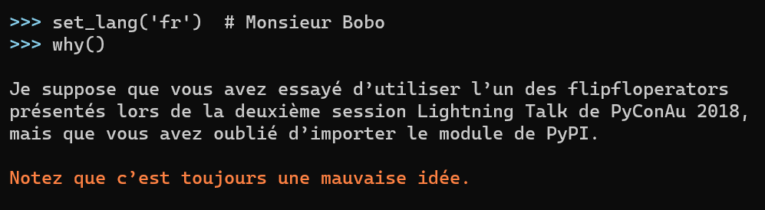
flipfloperator
Notes:
Assuming they are watching this talk, those french-speaking pythonistas should be pleased to know that friendly can give them information in their preferred language.
This is the end of a rather long introduction.

Slide 26
Outline of the rest of this talk
Original purpose of friendly-traceback
Evolution of friendly/friendly-traceback
Suggestions made
Various examples
Mu
Jupyter Notebooks
Justification after the fact
Conclusion
Notes:
For the rest of this talk, I’d like to give you a brief historical overview of the evolution of friendly (initially known as friendly-traceback), showing a few more examples.
Then I will attempt to justify the approach I used in developing friendly, by using some work from experts in the field.

Slide 27

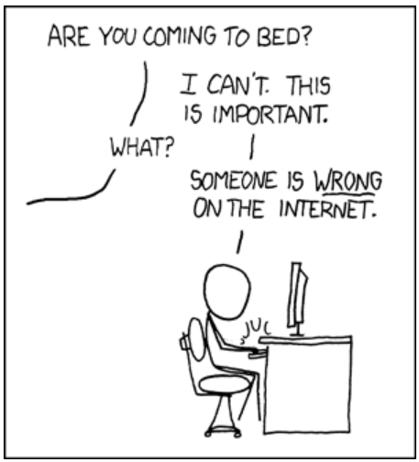
Purpose of this talk
Motivate you to use friendly with your students.
Motivate you to give me feedback to improve friendly.
Notes:
The purpose of this talk is to motivate you to use friendly with your students.
My hope is that, in return, you will provide me with some feedback so that I can make it even better.

Slide 28
Original purpose of friendly-traceback
Help students understand normal Python tracebacks
Notes:
When I created friendly-traceback, my initial idea was to create a tool that could help students decipher normal Python tracebacks, so that they could eventually learn to extract the “what, where, and why” on their own.

Slide 29
Original purpose of friendly-traceback
Provide accurate and easy to understand explanations for as many sources of Python exceptions as possible.
Translate these explanations in as many languages as possible.
Notes:
Initially, I thought of simply taking the message included in a traceback, reformulating it so that students could make better sense of it, and make it possible to translate this reformulated message into languages other than English.

Slide 30
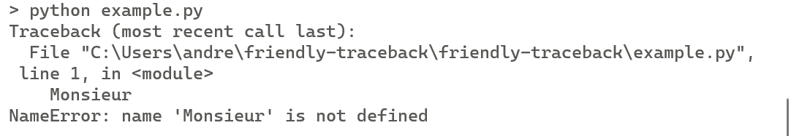
Original purpose of friendly-traceback
Notes:
So, given an error like what is shown – NameError: name ‘Monsieur’ is not defined.

Slide 31
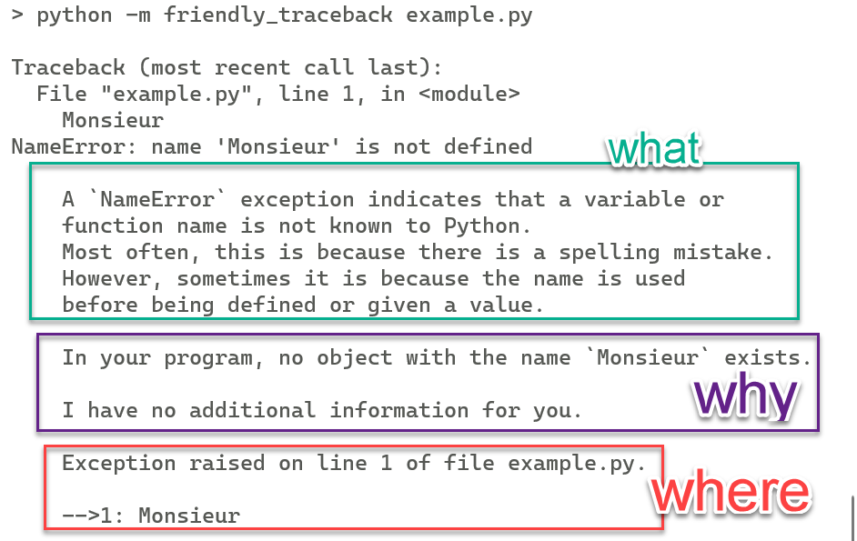
Original purpose of friendly-traceback
Notes:
Friendly-traceback was to provide all the information shown on this slide:
What is a NameError – an explanation that might be useful if such an error is encountered for the first time, but might become superfluous after a while.
Why this error might have occurred
Where exactly in the code.
This is the information provided by friendly-traceback with overlaid boxes on this slide to make it easier to parse.

Slide 32
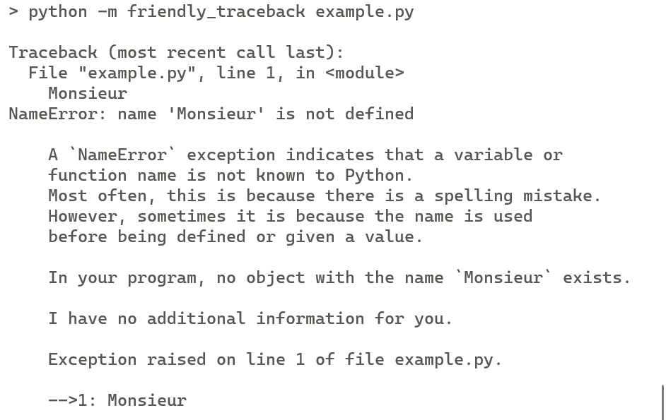
Original purpose of friendly-traceback
Notes:
Of course, in reality, these boxes are not present and we see a big chunk of text.

Slide 33
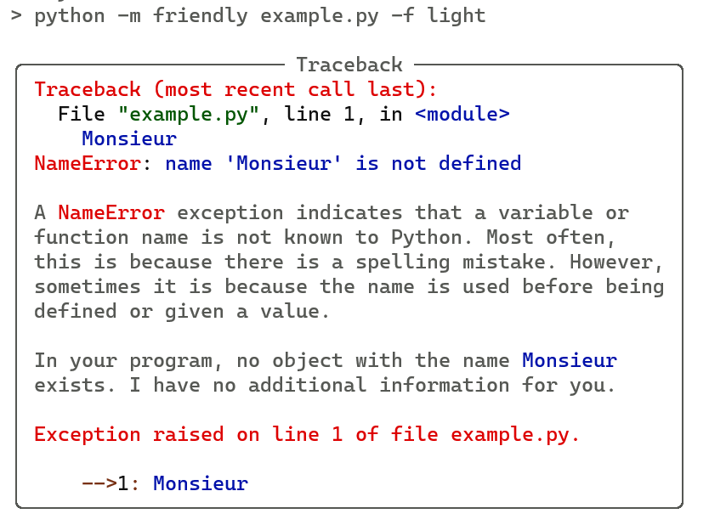
Original purpose of friendly-traceback
Notes:
Here, instead of using friendly-traceback, I ran friendly, which does some additional formatting, including adding colours.
These added colours should make it easier to parse the information.
Still, having all the information shown at once, especially with more complex examples, can lead to a huge wall of text.
This lead me to add the functions what(), where(), and why() that can be used interactively to obtain only parts of the information when required.

Slide 34
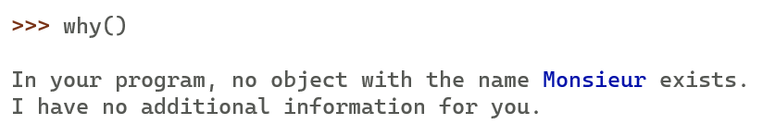
Original purpose of friendly-traceback
Notes:
For example: why().
In your program, no object with the name Monsieur exists. I have no additional information for you.
Originally, friendly-traceback did not add « I have no additional information for you » since that was always the case,
However, that has since changed, as I will show in a different example later..

Slide 35
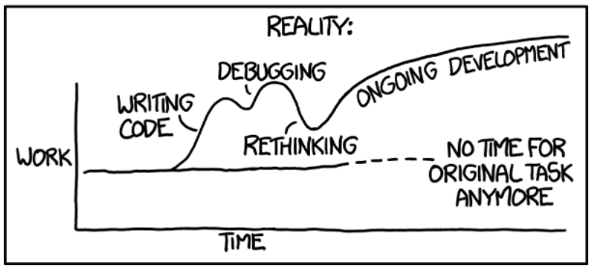
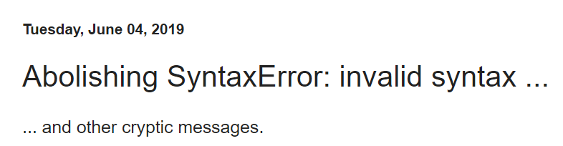
Scope creep
https://aroberge.blogspot.com/2019/06/abolishing-syntaxerror-invalid-syntax.html
Notes:
Of course, this approach of explaning what a given exception means and what might have cause the error simply based on the text provided by Python is not exactly helpful when the message is simply “invalid syntax”.
So, a little over two years ago, I figured out a way to automatically analyze a few “invalid syntax” cases, and wrote a blog post inviting other people to suggest additional examples.

Slide 36
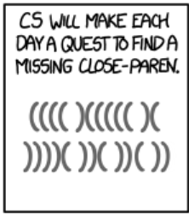
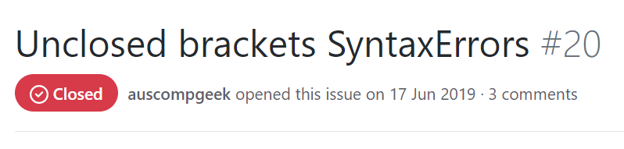
A few days later: first suggestion
Example shown later.
Notes:
It did not take long for the first suggestion to come in.
Over time, a few more suggestions were made, encouraging me to pursue further on my own and attempt to analyze more and more cases.

Slide 37
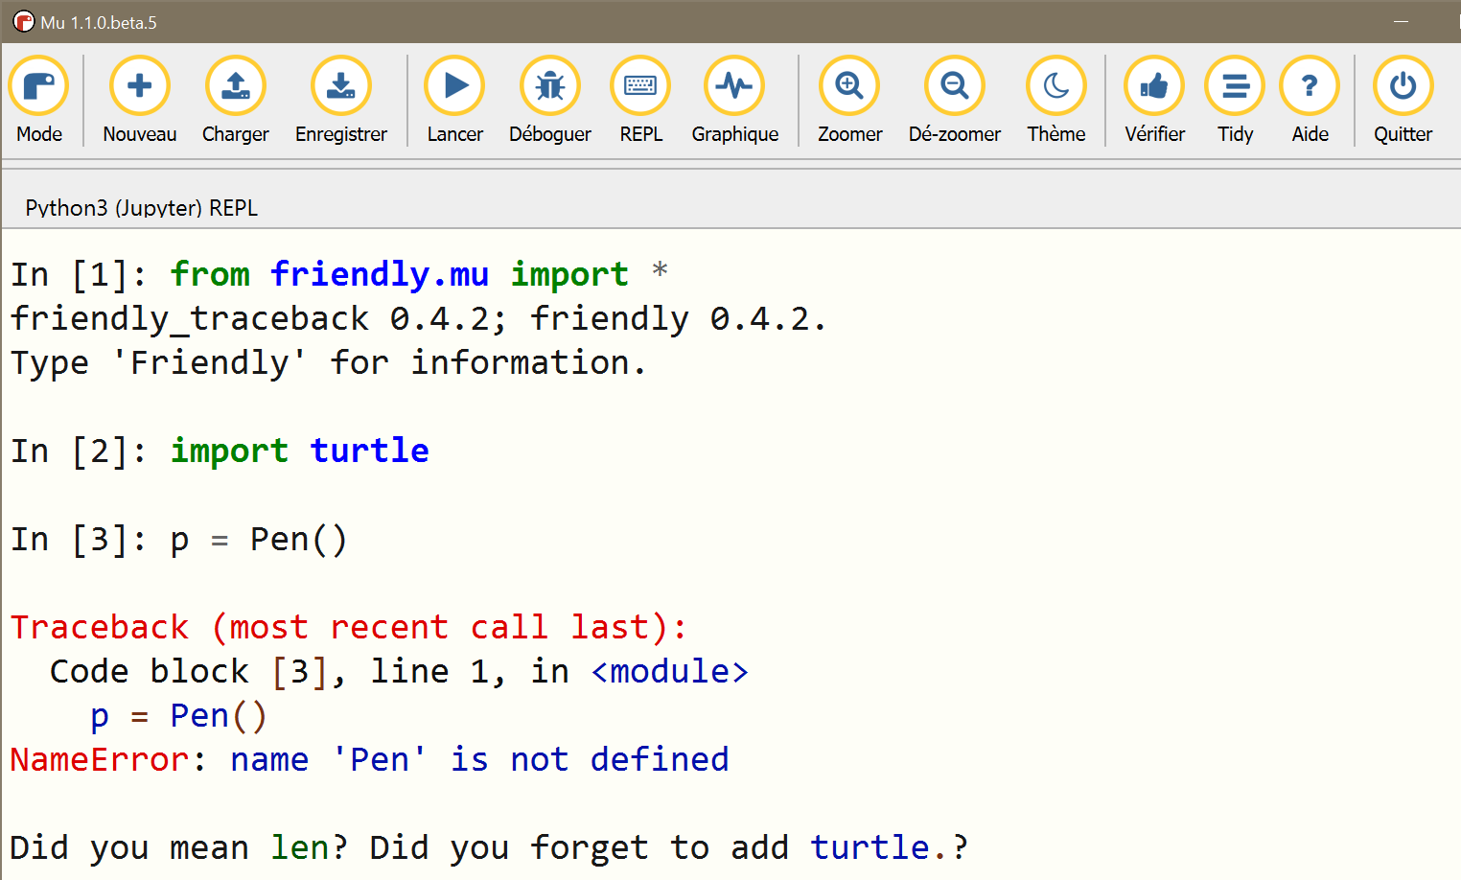
More and more cases added
Notes:
Here’s an example done while using Mu, arguably the most beginner-friendly editor that exists.
I first start by importing everything from “friendly.mu”.
After importing the turtle module, I try to call Pen, which results in a traceback.
Friendly’s hint at the bottom includes two suggestions: either a typo was made and I meant to write the builtin “len” instead of “Pen”.
Or, since Pen is an attribute of turtle (a module that was imported previously), perhaps a reference to that module is missing.

Slide 38
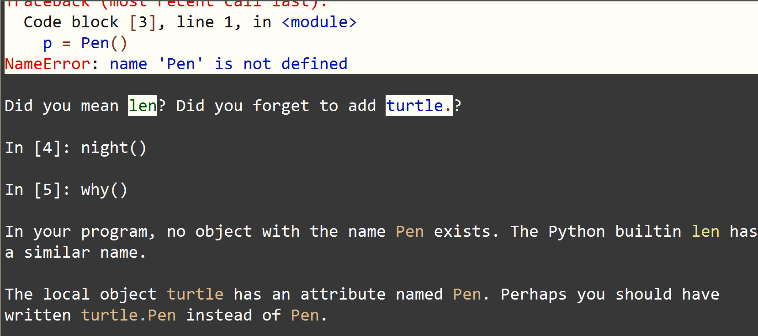
Different theming possible
Notes:
Mu has three different themes.
Switching to the night theme changes the colour … and the output provided by friendly no longer blends in.
When using friendly with Mu in the night theme, a student (or teacher) can type in “night()” so that the information displayed afterwards by friendly matches the theme used by Mu.
Asking why() results in a more detailed explanation than that given by the hint added at the bottom a the traceback by friendly.

Slide 39
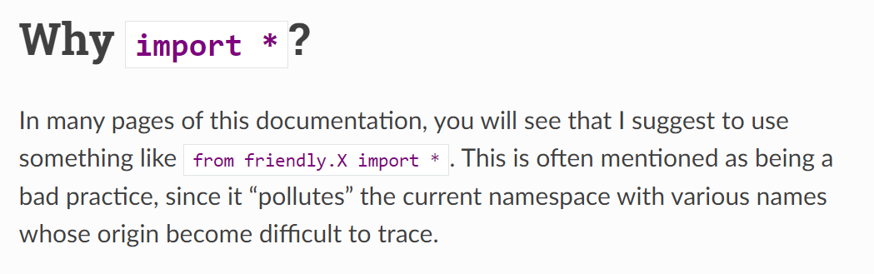
import *
https://friendly-traceback.github.io/docs/import_all.html
Notes:
In the previous example, you might have noticed that I used a star-import, which is generally frowned upon, usually for good reasons.
I don’t have enough time in this talk to explain why I nonetheless suggest to do so.
I invite you to consult the documentation for a detailed explanation, and for suggested alternatives specific to friendly, such as the one I will show in the next example.

Slide 40
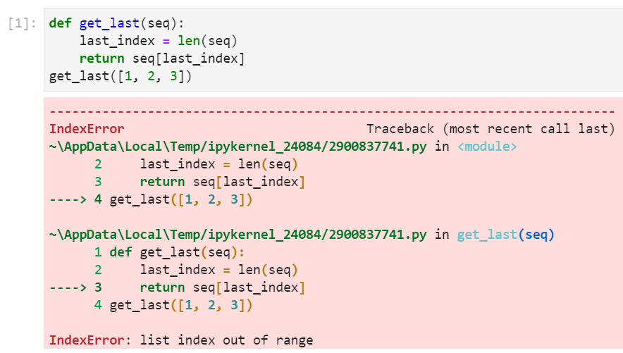
Jupyter example
Notes:
Here’s an example of a normal traceback created when using the latest version of Jupyter Lab.
The details of the code are not important. However, I want to draw your attention to the weird filename we see in the traceback.
How is a student supposed to make sense of this information?

Slide 41
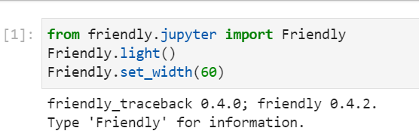
Jupyter example
Notes:
Let’s use friendly, this time by importing a single object from friendly.jupyter as an alternative to doing a star-import.
While it is not needed, I adjusted friendly’s theme to better match the Jupyter light theme.
I also set the width of friendly’s output so that it made for better screen captures for this talk.

Slide 42
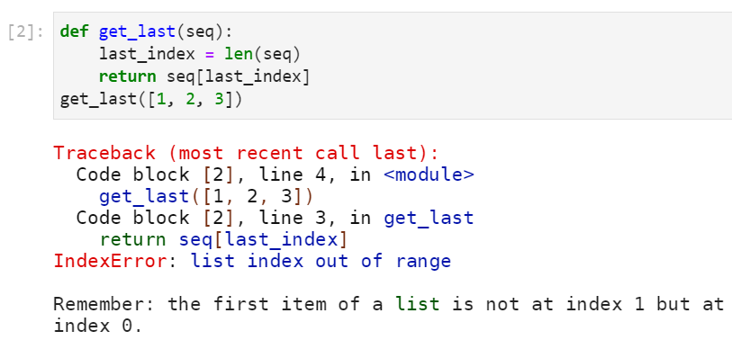
Jupyter example
Notes:
I now run the same code as before: notice how, instead of some weird filenames, the traceback includes references to Code blocks, which is the terminology used in Jupyter’s documentation.

Slide 43

Jupyter example
Notes:
If I want to know the cause of the problem according to friendly, this time, I cannot simply type the function “why” since I did not use the * import.
Instead, I can use the why() method of the Friendly object to achieve the same goal.

Slide 44

Before July 2021
Notes:
I’ve mentioned friendly and friendly-traceback.
Initially, the project was called friendly-traceback and later renamed friendly.

Slide 45
Now, separate projects
Before July 2021
Terminal
Idle
Mu
IPython, Jupyter
etc.
https://HackInScience.org
https://futurecoder.io
Notes:
At the end of June of this year, the project was split into two projects, moved from my personal github site to a new friendly-traceback “organization” I created.
Friendly-traceback does the analysis required to provide answers to the what, where and why mentioned before.
“friendly” takes care of providing the required formatting in a variety of environments (interpreter used in terminals, editors such as IDLE and Mu, Ipython console, Jupyter notebooks, etc.). It builds upon friendly-traceback. friendly is also the program most users should install.
Some third-party projects, such as the websites HackInScience and futurecoder, use the information provided by friendly-traceback and do their own formatting.

Slide 46

Now, separate projects
friendly
friendly-traceback
asttokens
executing
pure-eval
stack-data
colorama
pygments
rich
commonmark
typing-extensions
Notes:
This split was done at the request of one of these third-party users who found the additional dependencies to be detrimental to the performance of their site.

Slide 47

Approach used: examples added one at a time
General
Did you give your program the same name as a Python module?
A few rare specialized cases
Using the flipfloperator … is still a bad idea
Version 0.4.0: approximately 300 individual cases
Notes:
The approach I use in developing friendly is to add new examples one at a time, trying to find a way to automatically identify the relevant information and provide explanations that can be easily understood.
Currently, there are more than 300 individual cases for which friendly can provide an explanation.
This is usually done by asking what(), where() and why() in an interactive session.
While I keep adding new examples, I rarely go back and revisit explanations given in older examples. I encourage all of you to look at the examples, which are all available in the documentation site, and invite you to either suggest new examples or better explanations for the existing examples.

Slide 48
Can a REPL be user-friendly?
… or, how to deal with typos …
Notes:
When using an interactive interpreter, it is unfortunately very easy to make typos, causing spurious tracebacks.
Can an interactive Python interpreter be user-friendly?

Slide 49

Can a REPL be user-friendly?
Notes:
Here, I have some code that caused a traceback.

Slide 50

Can a REPL be user-friendly?
Notes:
I want to find out why … but I made a typo in writing the function name at the top. This should be easy to correct, given the hint provided by friendly.

Slide 51


Can a REPL be user-friendly?
Notes:
I typed it correctly this time … but it does not give me the explanation I needed: it told me that I made a mistake in typing out why(), which I already knew and has nothing to do with the first traceback.

Slide 52

Can a REPL be user-friendly?
Notes:
By using the history function, I can view all the exceptions raised so far.

Slide 53

Can a REPL be user-friendly?
Notes:
I can go back in history, thus erasing the latest mistake.

Slide 54

Can a REPL be user-friendly?
Notes:
I can now ask why() and get an explanation for the first traceback, as I wanted in the first place.

Slide 55


New for Jupyter notebooks and variants
Notes:
Since recording a first version of this talk, I’ve added a new way to use friendly within Jupyter notebooks and similar environments. Instead of having to type what, where or why, the user can simply click on buttons to show or hide the corresponding explanation – thus eliminating typo-related problems in these environments.

Slide 56

Am I making the right choices?
Notes:
In trying to improve friendly, there is always a question at the back of my mind: am I making the right choices?
So far, I have had some feedback from individual users, who are advanced Python programmers, but there has been no systematic evaluation done with actual beginners.

Slide 57
Justification after the fact
On Designing Programming Error Messages for Novices: Readability and its Constituent Factors
Paul Denny, Brett A. Becker, Catherine Mooney, John Homer, Zachary C. Albrecht, Gary B. Powell
CHI Conference on Human Factors in Computing Systems, May 2021.
https://www.youtube.com/watch?v=5-k9f3iFzXQ
https://dl.acm.org/doi/fullHtml/10.1145/3411764.3445696
Notes:
In the absence of such studies, I recently read a paper on that topic, after I saw a link to it on Twitter.
On Designing Programming Error Messages for Novices: Readability and its Constituent Factors.

Slide 58
I have read a paper, therefore I am an Internet expert
On Designing Programming Error Messages for Novices: Readability and its Constituent Factors
“In educational contexts, the detrimental effects of cryptic error messages on novice programmers have been reported throughout the literature for decades…”
Notes:
I noted while reading thisatpaper, that the problems associated with bad error messages have been discussed for a few decades, without being solved.

Slide 59

On Designing Programming Error Messages for Novices: Readability and its Constituent Factors
Important factors for readability: length and jargon
Remove jargand acronyms
Write messages in complete sentences
Use an economy of words.
se simple vocabulary
Notes:
According to that paper, there are two important factors for readability of error messages: message length and use of jargon.

Slide 60
On Designing Programming Error Messages for Novices: Readability and its Constituent Factors
Important factors for readability: length and jargon
Remove jargand acronyms
Write messages in complete sentences
Remove jargon and acronyms
Use an economy of words.
Write messages in complete sentences
Use simple vocabulary
Use an economy of words.
se simple vocabulary
Notes:
Ideally one should:
Remove jargon and acronyms
Write messages in complete sentences
Use simple vocabulary
Use an economy of words – so complete but short sentences.

Slide 61
On Designing Programming Error …
“We focus on readability which, we argue, is more fundamental [than usability] ”
Notes:
The paper focused on readability which the authors deem to be more fundamental than usability.

Slide 62
On Designing Programming Error …
“We focus on readability which, we argue, is more fundamental [than usability] ”
Usability: How actionable a message is?
Information about error locality
Message precision
Notes:
By usability, they mean how useful is the information provided in finding a solution to the problem.

Slide 63
On Designing Programming Error …
Student evaluations of error messages from Java, C, Python.
Notes:
The authors had groups of students evaluating error messages from Java, C, and Python.
I expected the results to be that error messages from Java were too verbose, those from C too cryptic, and those from Python just right.

Slide 64

On Designing Programming Error …
Student evaluations of error messages from Java, C, Python.
Python was rated the worst.
Notes:
I was wrong: error messages from Python were rated as the worst of the three.
Let’s consider why that might be the case, using the first example shown at the beginning of this talk.

Slide 65
Readability vs Usability
Python 3.6 and 3.7
AttributeError: module 'turtle' has no attribute 'forward’
Notes:
Prior to version 3.8, the error message provided by Python was relatively short: module turtle has no attribute forward.
This message did not contain any additional information about the actual cause.

Slide 66
Readability vs Usability
Python 3.6 and 3.7
AttributeError: module 'turtle' has no attribute 'forward’
Python 3.8+
AttributeError: partially initialized module 'turtle' has no attribute 'forward' (most likely due to a circular import)
Notes:
Then more information was added, potentially useful to more advanced programmers, but full of jargon that cannot be understood by beginners.

Slide 67
Readability vs Usability
Python 3.6 and 3.7
AttributeError: module 'turtle' has no attribute 'forward’
Python 3.8+
AttributeError: partially initialized module 'turtle' has no attribute 'forward' (most likely due to a circular import)
Python + friendly
Did you give your program the same name as a Python module?
Notes:
However, when using friendly with any Python version, an additional hint is provided, which should be more easily understood by beginners.

Slide 68


Readability vs Usability
Notes:
To be fair, I must note some recent improvements for Python, where some “invalid syntax” messages have been replaced by something more useful.
For example, errors due to forgetting to close a parenthesis are now identified correctly in Python 3.10.

Slide 69

Using friendly
Notes:
Here is the same example run with friendly, which gives the same correct explanation for all supported Python versions, even if we only get an « invalid syntax » error message.

Slide 70
Error messages: different principal target audiences
Python
Precise, technical English
Intermediate to Advanced
Friendly
Simple English
Simple French, etc.
Beginner to Intermediate
Notes:
Python caters to all kinds of programmers, from beginners just learning the basics to advanced programmers using Python in their daily job.
When it comes to error messages, it would seem that Python seeks a middle ground and occasionally uses jargon not accessible to beginners.
By contrast, friendly attempts to cater to such beginners.

Slide 71



NoneType object is not subscriptable
Notes:
Let’s have a look at a different example where Python gives an error message that is rather obscure for beginners.
Nonetype object is not subscriptable.

Slide 72


NoneType object is not subscriptable
Notes:
Asking why() gives us an explanation, but no actual clue as to what the object causing the problem is.
The note at the bottom explains what the NoneType jargon means.

Slide 73

NoneType object is not subscriptable
Notes:
Asking where() gives us more information.
Friendly-traceback always attempts to isolates the part of the code that causes problems and identify the value of each object.
Here, we have a dict x containing other Python dicts.
At the very bottom, we can see that x[42][1][2] has the value of None, which is the cause of the problem.

Slide 74

To find out more
python –m pip install friendly
Notes:
This almost concludes this introductory talk to friendly and friendly-traceback.
To find out more, you could use a search engine to find friendly’s documentation …. But there is a better way.
First, install friendly

Slide 75

To find out more
Notes:
Start the friendly console

Slide 76

To find out more
Notes:
Typing in Friendly provides some basic help

Slide 77

To find out more
>>> www() # Goes to documentation
>>> www(‘bug’) # Contribute!
Notes:
To find out even more, type www().
Assuming you write this function call without making any typo, no exception will have been raised and instead of doing an internet search, www() will take you to friendly’s documentation.
As an addition to unit tests, I record almost all of the example tracebacks for different Python versions in the documentation. This occasionally helps to spot regressions. It is also useful to review the explanation given. I encourage you to do so and make suggestions to improve them.
You might also come across some notices about “Design choices”. These are to record choices I made for friendly-traceback, inviting you to comment about their suitability.
Of course, using pip to install packages such as friendly is often something that beginners find difficult. Ideally, there should be a better way.

Slide 78


The future?
Notes:
Perhaps, friendly will be installed by default in a future version of Mu, as has been recorded on Mu’s github repo by Nicholas Tollervey, Mu’s creator.

Slide 79

The future?
Notes:
One of the main Ipython and Jupyter developer has expressed support for enabling friendly by default if it is installed.

Slide 80

Conclusion
Use it
Read the documentation
Design choices
Give feedback!
Notes:
In conclusion: I invite you to try out friendly, read the documentation, and give feedback so that I can hopefully make friendly even more useful for you and for your students.

Slide 81

Questions?
Notes:
And, of course, I welcome any question you might have.

